Slide 1
Workflow Management Systems
Used for scientific workflows for data analysis
Pipelines (automated workflows)
  Sequence of tasks
    E.g. gathering, cleaning, and processing data
  Can work with multiple software packages
  Taking over from the messy/traditionally set-up of joined scripts in bash
Important tools for our battle with the reproducibility crisis!

Slide 2


Workflow Management Systems
Features:
  Compute resource management
  Software management
  Checkpointing and resumption
  Portability & Interoperability
  Reproducibility
 | Nextflow | Snakemake
Language | Groovy (a Java dialect) | Python
Workflows | nf-core | wrappers
Usage | more industry | more academia

Slide 3
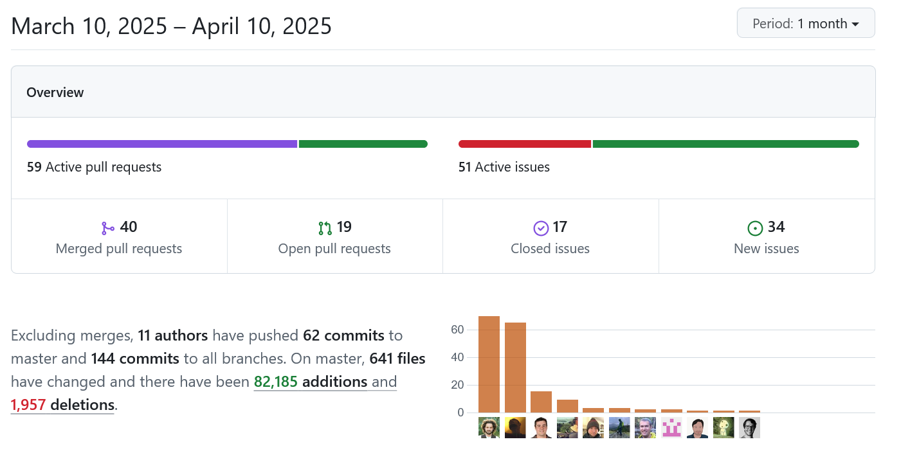
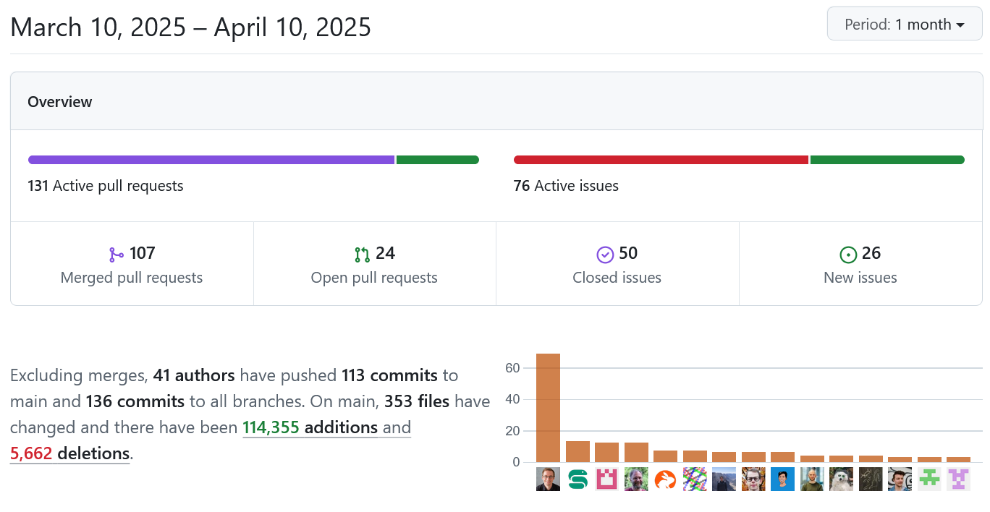
Workflow Management Systems
Active development (GitHub)
Community driven (Hackathons)

Slide 4
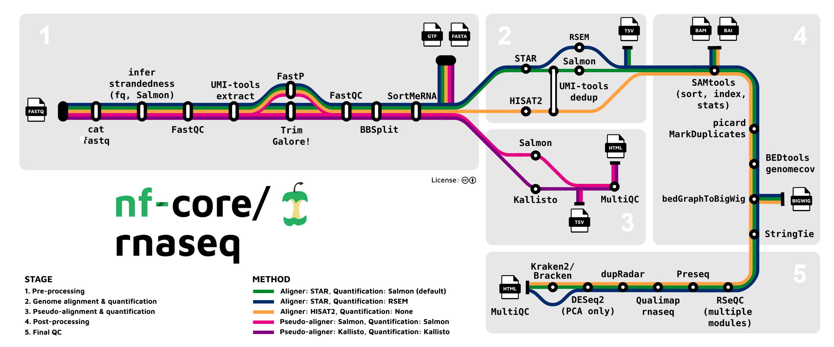
Nextflow
Write your own pipelines or use published workflows/module (https://nf-co.re)
Config file for the cluster: https://nf-co.re/configs/cropdiversityhpc/
srsh --mem=12Gb --cpus-per-task=2
mkdir Testing
nextflow run nf-core/rnaseq -profile test,cropdiversityhpc --outdir .

Slide 5
Interested in learning more:
Online training and tutorials:
  https://training.nextflow.io/latest/ and https://www.nextflow.io/
  https://snakemake.readthedocs.io/en/stable/tutorial/tutorial.html
Problems:
  GitHub issues
  Slack Channel (Nextflow or Cropdiversity HPC)

